Slide 1
Mobile and Wireless Technology CT090-3-2-MWT Version VD01
WLAN Terminology and Technology

Slide 2
Topic & Structure of The Lesson
Wireless LAN Modes of Operation - Ad-hoc & Infrastructure
Connecting to a Wireless Network – Passive Scanning & Active Scanning
Distribution System (DS)
Data Rates, Throughput, Dynamic Rate Switching
WLAN Roaming

Slide 3
Learning Outcomes
At the end of this topic, You should be able to
Understand the different operation modes for IEEE 802.11 wireless networks.
Be familiar with the different service sets used with wireless networking.
Identify the terminology used with IEEE 802.11 wireless networking. Know the process devices use to join a wireless LAN.
Understand the differences between distribution systems as well as data transfer.
Identify the differences as well as the function of a distribution system and wireless distribution system and roaming between each.
Know the differences between data rate and throughput as well as dynamic rate switching

Slide 4
Key Terms You Must Be Able To Use
If you have mastered this topic, you should be able to use the following terms correctly in your assignments and exams:
BSS(Basic Service Set)
ESS(Extended Service Set)
IBSS(Independent Basic Service Set)
SSID(Service Set Identifier)

Slide 5
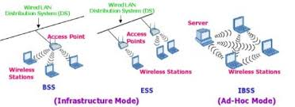
Wireless LAN Modes of Operation
802.11 wireless LANs may be configured in one of two modes, either ad hoc or infrastructure mode.
These two modes can be broken down into three different configurations:
Independent basic service set (IBSS)
Basic service set (BSS)
Extended service set (ESS)

Slide 6
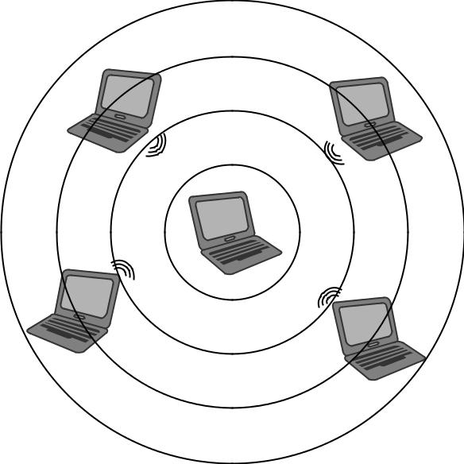
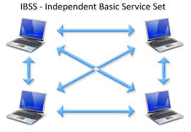
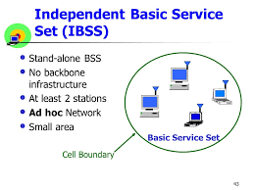
Wireless LAN Modes of Operation - IBSS
This operation mode uses no access points and consists of only wireless LAN devices or client computers. Communication occurs only among devices that are part of the same IBSS. Unlike an access point, this mode has no centralized control or managed security features.

Slide 7
Wireless LAN Modes of Operation - IBSS
Certain parameters must be set on the devices that wish to participate in an IBSS. These parameters must be the same on all the devices in order for them to effectively communicate with one another. Three common parameters set on devices that belong to the same IBSS are:
Service set identifier (SSID)
Radio frequency channel
Security configuration

Slide 8
Wireless LAN Modes of Operation – IBSS
Service set identifier (SSID) - The SSID is the name of the service set used to identify the wireless network and for device segmentation. The SSID is used by devices to select a wireless network to join.
Every device that wishes to be part of the same wireless LAN IBSS, BSS, or ESS will use a common SSID. For infrastructure devices such as access points, the SSID parameter is manually set on the access point.
From the client access side, the SSID is a user-configurable parameter that can be set manually in the client software utility or received automatically from networks that broadcast this parameter.

Slide 9
Wireless LAN Modes of Operation - IBSS
Networks that are set to broadcast the SSID—also known as open networks—allow other devices to connect and use resources from the network based on the designated permissions or rights of the resource.
The SSID is case sensitive and has a maximum limit of 32 characters or, as specified in the IEEE 802.11 standard, 32 octets.

Slide 10
Wireless LAN Modes of Operation - IBSS
Radio frequency channel - The IBSS configuration requires a user to set the specific RF channel that will be used by all devices that are part of the same IBSS network.
This is accomplished in the client utility software for the network adapter. Some client software utilities set this automatically, in which case the IBSS will use the channel automatically specified.
It is important to understand that all devices in any common IBSS must be communicating on the same channel. If the client utility does allow a channel to be set, the channel chosen is up to the user but based upon the regulatory domain in which the network is used.

Slide 11
Wireless LAN Modes of Operation - IBSS
Security
With IBSS networks, there is no centralized control and no security management features.
Security is left up to the individual user or device. If a user inadvertently shares a resource it could expose sensitive information and pose security threats.
This can be a concern for many enterprise installations and therefore the use of an IBSS may be against corporate policy.

Slide 12
Wireless LAN Modes of Operation - BSS
The basic service set (BSS) is the foundation of the wireless network. This mode consists of an access point connected to a network infrastructure and associated devices.
This is considered the foundation because it may be one of many access points that form a wireless network.
With a BSS setup, each access point is connected to a network infrastructure, also known as the distribution system (DS) and allows connected wireless LAN devices to access network resources based on the appropriate permissions the device or user has access to.

Slide 13
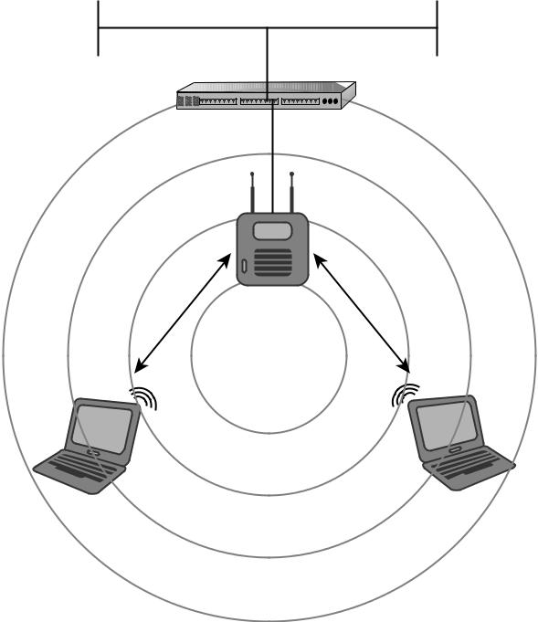
Wireless LAN Modes of Operation - BSS
The radio frequency area of coverage depends on several factors such as the antenna gain and output power settings; this area of coverage is known as the basic service area(BSA).
Any wireless device in radio range and part of the BSA with the correct configuration parameters, including SSID and security settings, will be able to successfully connect to the access point. Figure 7.5 shows an example of a BSS.

Slide 14
Wireless LAN Modes of Operation - ESS
Extended service set (ESS) is defined as “a set of one or more interconnected basic service sets (BSSs) that appears as a single BSS to the logical link control (LLC) layer at any station (STA) associated with one of those BSSs.”
In basic terms, this can be one or more basic service sets connected to a common distribution system. An ESS is a common configuration in many wireless LAN deployments for small to medium businesses as well as large enterprise organizations.
In most cases, an ESS would be used to provide consistent and complete coverage across an entire organization.

Slide 15
Wireless LAN Modes of Operation - ESS
An ESS can be thought of as several basic service sets (BSSs) that have matching parameters such as SSID and security settings.
It is the distribution system connecting these together that makes up the ESS. In most cases, the basic service area for each BSS will overlap to allow roaming from one BSS to another.

Slide 16
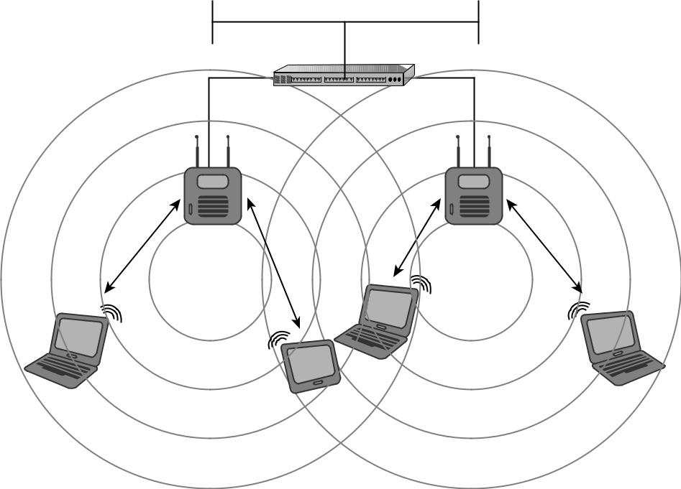
Wireless LAN Modes of Operation - ESS
ESS - Extended Service Set

Slide 17
Connecting to a Wireless Network – Passive Scanning
The first part of the discovery phase in IEEE 802.11 of wireless networking is known as passive scanning. This process allows wireless LAN devices to “listen” for information about wireless networks in the radio receiving area of the wireless network or the BSA.
During the passive scanning process, wireless LAN devices will listen for specific information to make them aware of networks in the area. An analogy to this process would be using an FM radio tuner to scan through the entire band listening for a station to tune in.

Slide 18
Connecting to a Wireless Network –
Active Scanning
Active scanning is another part of the wireless LAN discovery phase. In active scanning, wireless LAN devices wishing to connect to a network send out a frame known as a probe request.
The function of this management frame is to find a specific wireless access point to connect with. Depending on the client software used, if an SSID is specified in the client utility software active profile, the device will join only a network with the matching SSID.
Access points constantly listen for probe request frames. Any access point within hearing range of the wireless device and having a matching SSID sends out a probe response frame to the wireless device.

Slide 19
Connecting to a Wireless Network – Authentication
Authentication in general is defined as verifying or confirming an identity.
- We use a variety of authentication mechanisms in our daily lives, such as logging onto a computer or network at home or at the office, accessing secure sites on the Internet, using an ATM machine, or showing an identification badge to get access to a building.
IEEE 802.11 devices must use an authentication process in order to access network resources. This authentication process differs from conventional authentication methods such as providing a username and password to gain access to a network.

Slide 20
Connecting to a Wireless Network – Authentication
The authentication discussed here is device authentication, required in order for the device to become part of the wireless network and participate in exchanging data frames.
The IEEE 802.11 standard addresses two types of authentication methods: open system and shared key.

Slide 21
Connecting to a Wireless Network – Association
Association takes place after a device has been successfully authenticated either by open system or by shared key authentication.
In the association state, the authenticated device can pass traffic across the access point to the network infrastructure or other associated wireless devices, allowing access to resources that the device or user has permissions to access.
After a device is authenticated and associated, it is considered to be part of the basic service set. A device must be authenticated before it can be associated.

Slide 22
Distribution System
In wireless LAN technology, the distribution system (DS) is the common infrastructure to which access points are connected and can be wired or wireless. In most cases this would be Ethernet.
In this capacity, the access point acts like a Layer 2 translational bridge. A translational bridge is defined as a device used to connect two or more dissimilar types of LANs together, such as wireless (802.11) and Ethernet (802.3).
From a receiver’s perspective, this allows an access point to take information from the air (the communication medium in wireless networking) and make a decision either to send it back out to the wireless radio or to forward it across to the distribution system.

Slide 23
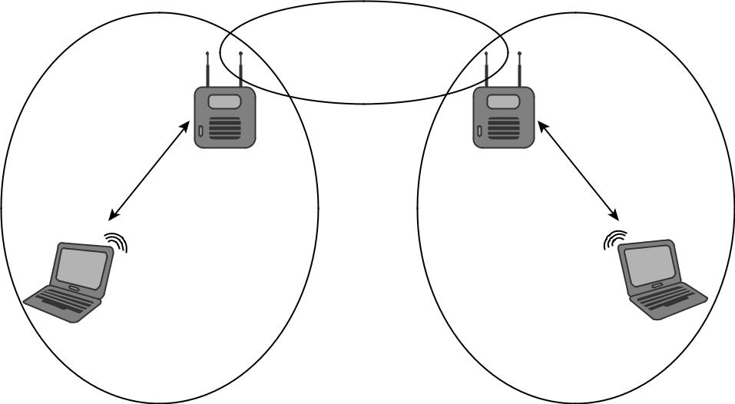
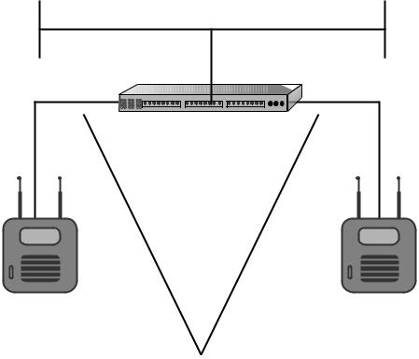
Distribution System
An access point can do this because it has enough intelligence to determine if a data frame is destined to be sent to the distribution system or if it should stay on the wireless side of the network. This is possible because the access point knows whether a device is part of the wireless LAN side through the authentication and association methods mentioned earlier.

Slide 24
Distribution System
The distribution system is a network segment that consists of one or more connected basic service sets. As mentioned earlier, according to the original IEEE 802.11 standard, one or more interconnected basic service sets make up an extended service set.
The distribution system allows wireless LAN devices to communicate with resources on a wired network infrastructure or to communicate with each other through the wireless medium.
Either way, all wireless frame transmissions will traverse through an access point. In some cases it may be feasible and justified to use a wireless distribution system

Slide 25
Data Rates & Throughput
The speed in which wireless devices are designed to exchange information is known as the data rate. Data rates do not accurately represent the amount of information that is actually being transferred between devices and a wireless network. This is done by throughput.
Throughput is the amount of information actually being transmitted or received.
Many variables affect the actual throughput of information being sent. Some of these include:
Spread spectrum or technology type in use
RF interference
Number of users connected to an access point

Slide 26
Data Rates & Throughput
Table 7.1 Data Rates Based on Spread Spectrum Type
Standard/Amendment Technology Data Rates
802.11 FHSS 1 2 Mbps
802.11 DSSS 1 and 2 Mbps
802.11b HR/DSSS 5.5 and 11 Mbps; 1 and
2 Mbps from DSSS
802.11a OFDM 6, 9, 12, 18, 24, 36 and
48 Mbps
802.11g ERP-OFDM 6, 9, 12, 18, 24, 36 and
48 Mbps
802.11n HT-OFDM Up to 300 Mbps

Slide 27
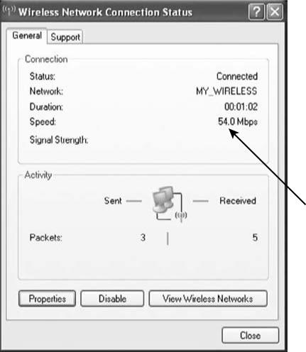
Data Rates & Throughput

Slide 28
Data Rates & Throughput
For example, an 802.11b wireless access point has a maximum data rate of 11 Mbps. With one user connected to this access point, chances are the best throughput that could be expected is about 50 percent of the maximum, or 5.5 Mbps.
If more users connect to the same access point, the throughput for each user would be even less, because of the contention between users sharing the same wireless medium.

Slide 29
Dynamic Rate Switching
When a wireless device moves through the BSA or as the distance from the access point increases, the data rate will decrease.
This is called dynamic rate switching (DRS), also known as dynamic rate selection. This process allows a device to adapt to the RF in a particular location of the BSA.
DRS is typically accomplished through proprietary mechanisms set by the manufacturer of the wireless devices. The main goal of dynamic rate switching is to improve performance for the wireless device connected to an access point.

Slide 30
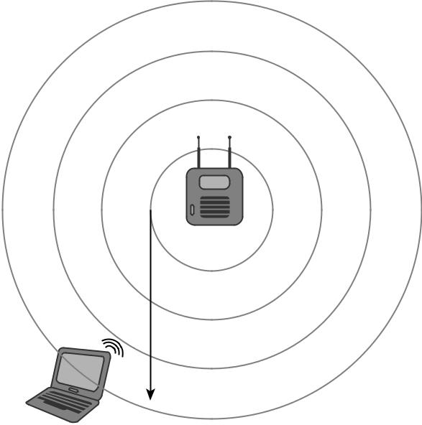
Dynamic Rate Switching

Slide 31
Roaming
In wireless LAN technology,
Roaming is the term for what happens when a device moves from one basic service set to another. Roaming is not addressed in the original IEEE 802.11 standard.
This process is typically accomplished in a proprietary manner based on how the manufacturer chooses to implement it. Manufacturers use different criteria to initiate roaming from one access point to another.

Slide 32
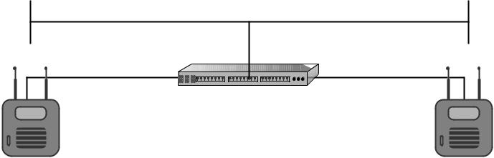

Roaming
When a wireless LAN device moves through a BSA and receives a signal from a second access point, it needs to make a decision whether to stay associated to the current access point or to re associate to the new access point.

Slide 33
Roaming
This decision when to roam is proprietary and based on specific manufacturer criteria.
Some of these criteria are:
Signal strength
Signal to noise ratio
Error rate
Number of currently associated devices

Slide 34
Roaming
When a wireless LAN device chooses to re associate to the new access point, the original access point will hand off the association to the new access point as requested from the new access point. This is done over the wired network or distribution system based on how the manufacturer implemented the roaming criteria.

Slide 35
Quick Review Question
What is Dynamic rate switching?
What is active and passive scanning?
Define IBSS,BSS and ESS.
What is roaming?

Slide 36
Summary of Main Teaching Points
WLAN Mode of Operation
– Ad-Hoc and Infrastructure
- three configurations IBSS,BSS & ESS
Connecting to a wireless Network –
-Passive Scanning, Active Scanning, Authentication, Association,
Distribution System
Data Rate and Throughput
Dynamic Rate Switching
Roaming

Slide 37
Question and Answer Session
Q & A

Slide 38
What we will cover next
Wireless LAN Threats and Intrusion
IEEE 802.11 Standards Security
Open System Authentication
Shared Key Authentication
Early WLAN Security Mechanisms
Service Set Identifier (SSID)
SSID Hiding
Media Access Control (MAC) Address
Overview of other WLAN Security Standards and Technology

